Slide 1

A Genetic Algorithm for Efficiently Connecting Cities
Michael Nelson & Wyatt Goeks

Slide 2
Introduction & Motivation
The problem that our genetic algorithm solves is how to create the most efficient possible set of paths between cities, where efficiency is defined as a weighted sum of cost to construct a segment of road, the time it takes to travel that segment, and the elevation change over that segment
Designing road networks can be an immensely difficult task:
Our algorithm aims to simplify the design process by suggesting the optimal series of starting routes
Routes can then be modified as engineers and civil planners require

Slide 3
Related Works
‘A genetic algorithm approach to multi-objective land use planning’ describes the benefits of using geographical data to speed up the amount of calculations done by a genetic algorithm
‘Performance of a Genetic Algorithm for Solving the Multi-Objective, Multimodal Transportation Network Design Problem’ discusses the impact of the mutation rate on a genetic algorithm’s success
‘Transit network design by genetic algorithm with elitism’ deals with a similar problem to ours, but focuses entirely on minimizing transit time within a city

Slide 4
Related Works ct’d
‘Combining VNS with Genetic Algorithm to solve the one-to-one routing issue in road networks’ combines a genetic algorithm and a variable neighborhood search to replace calls to Dijkstra’s algorithm in a bid to increase algorithmic efficiency
‘Are Motorways Rational From Slime Mould’s Point of View?’ is the inspiration for our project, and seeks to describe the accuracy with which a variety of mold can model various countries’ intercity road networks

Slide 5
Research Gap
Many papers have published findings about semi-similar problems
But, we were unable to find one that focused on how to efficiently create a network of roads while accounting for cost, travel time, and elevation differences
We sought to create a computational version of the slime-mold experiment from the last paper cited

Slide 6
Proposed Algorithm - Overview
Use a Genetic Algorithm’s mimicry of the evolutionary / sexual selection process
Involves combining two individuals’ traits via ‘breeding’ function
Accounts for genetic variation with a ‘mutate’ function
Assesses individuals based on ‘fitness’ – in this case, path weight
Survival of the fittest

Slide 7
Proposed Algorithm - Pseudocode
Use a random-walk algorithm to generate the starting population
Clean up the starting population by removing loops
Assess the cost of each individual
Mutate individuals (shift points in their paths slightly)
Breed suitable individuals (and cleanup child paths)
Cull inefficient / costly individuals
Repeat as necessary until there’s no appreciable improvement after a set number of generations

Slide 8
Proposed Algorithm - Variables
Data set (geodetic data: evenly-spaced elevation data points)
Datapoint offset: how far (ft) are the data points from one another
Weights for distance (length of road in feet), cost to build the proposed road (USD), and tolerable amount of delta incline (steeper transitions are less desirable)
These 3 weights should sum to 1.0

Slide 9
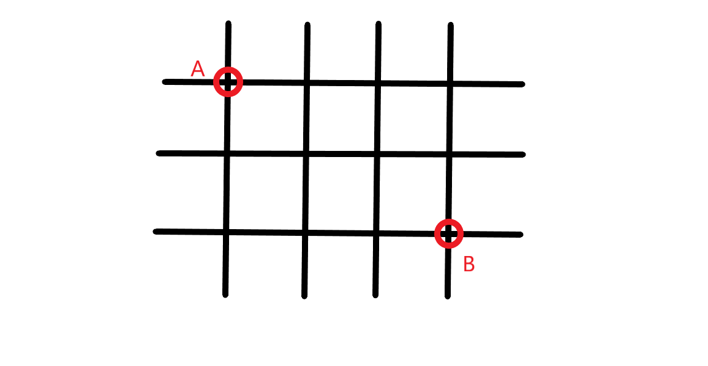
Proposed Algorithm – Use Case Analysis
<- Create Starting Paths
Remove loops ->
Now that we have clean paths, mutate them (bottom right)
Breed with crossing paths (bottom left)
RED: parent 1
GREEN: parent 2
PURPLE: child 1
BLUE: child 2
Repeat until path cost does not decrease between generations

Slide 10


Implementation Details
Originally planned to use DEAP library, Distributed Evolutionary Algorithms in Python
However, we found that DEAP didn’t support our needs, and we ended up writing the entire GA from scratch
Written in Python, using math, matplotlib, time, random, csv, and enum libraries
~600 lines of code

Slide 11
Implementation Details
Dataset: since we had difficulty finding usable data, we ended up creating a set of dummy data
Performance: For input of size 10 x 10 x N generations with a mutate factor of 0.1, the algorithm ran in 6.5 to 7.5 minutes

Slide 12
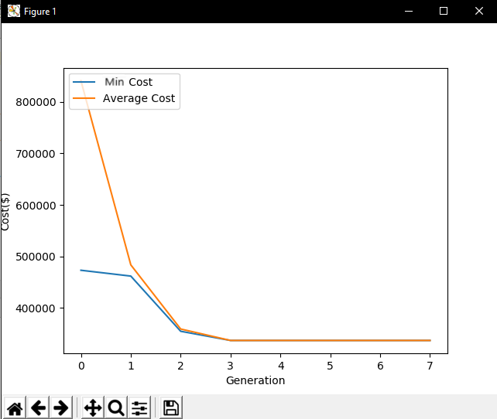
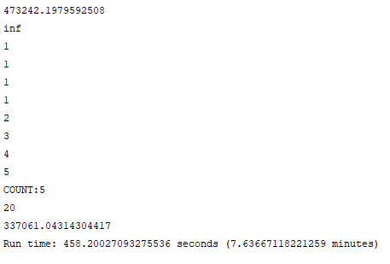
Screenshots & Graphs
Run-time for 10x10 array of data, with requirement of 5 changeless generations to terminate: ~7 minutes (on the slower of our two laptops)
Minimum route cost: $337,061.04
Max cost and average cost both decrease quickly over generations
The integers 1-5 on the left show the number of generations passed without improvement over the previous

Slide 13
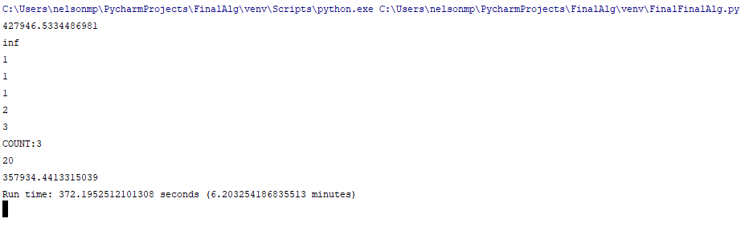
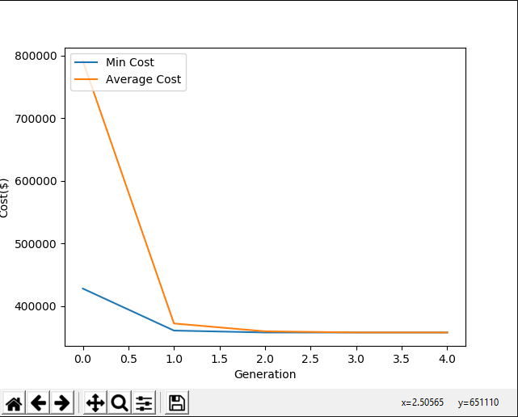
Screenshots ct’d

Slide 14

Dummy Data
At first, randomly generated array
Eventually, we switched to a custom-made data set that had natural differences in elevation and areas that the algorithm deemed impassable

Slide 15
Result Analysis
Overall, the algorithm succeeds in finding a direct, efficient, and low-cost route between cities: due to the nature of genetic algorithms, it is difficult to determine if the solutions it presents are the optimal ones
For example, with randomly generated data, the algorithm repeatedly found a route of significantly less cost than the original solutions:
i.e. an initial cost of 1314302.42 is reduced to 306618.28

Slide 16
Analysis ct’d
In conclusion, despite the solid results it delivers, this algorithm is probably not the best choice for solving this particular problem
Takes a long time to run
May be possible to use dynamic programming or other algorithmic methods to reduce runtime and improve performance
We learned an awful lot about genetic algorithms and the principles behind them over the course of this project

